Slide 1
Nick Calow
Ames, Iowa Housing Analysis

Slide 2
Overview
Data Science Problem: How can one predict future sale prices based upon housing data in Ames, Iowa?
Using model building techniques and some experimental feature selection, the problem has begun to have been solved

Slide 3
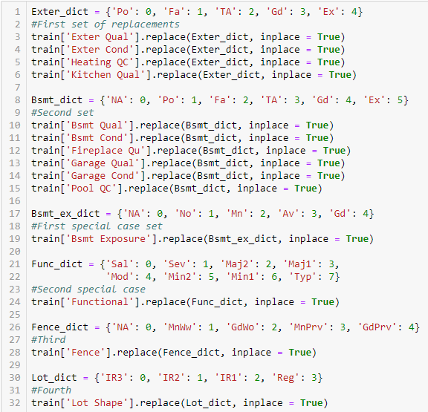
Initial Data Cleaning
So many ordinal variables
Numeric values:
good analysis

Slide 4
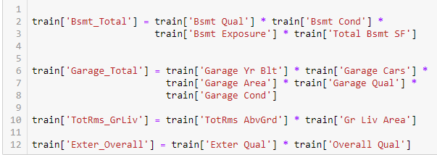
Feature Engineering
Garage and Basement
Interesting interactions
Few dummies(Neighborhood, House style, etc.)

Slide 5
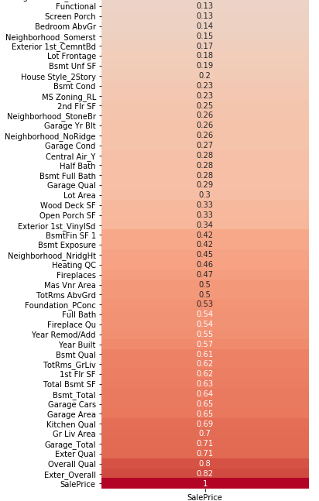
Initial Feature Selection
Slice from a larger Heatmap
Some high interactions
Some trouble finding the right mix

Slide 6
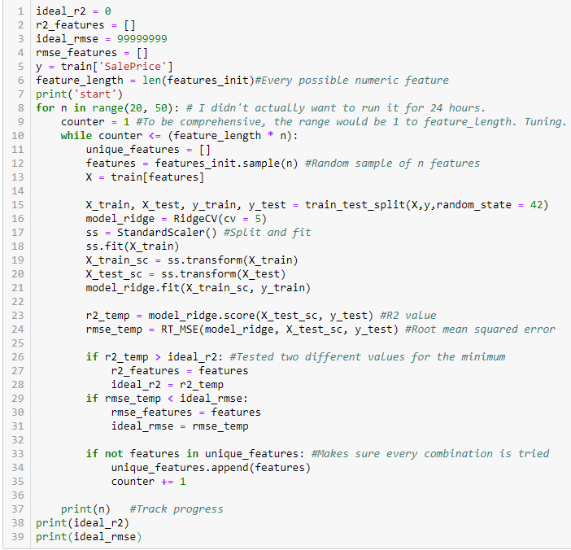
“The Experiment”

Slide 7
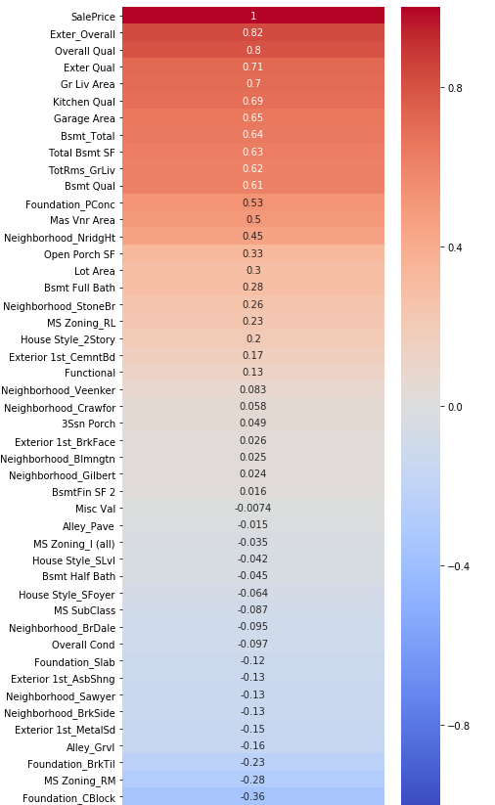
Results
The wonders of black box programming.
Other metrics at play here
R² ended up being around 90%(with log transformation)

Slide 8
Conclusions
Points for consideration:
  Strong foundation
  Large area
  Right neighborhood
  High quality
The best solution may not be readily apparent.

